Slide 1
R in Eighty Days

Slide 2
Intro…
1. An R novice
5. My objectives
2. < 80 days
6. The unknowns
3. My baggage
4. My angle

Slide 3
Visualize…

Slide 5
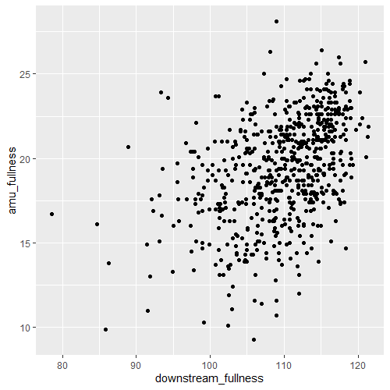
The Top Right Hand Corner of Doom
STEP 1: plot the basic data by copying the R for Data Science mpg example
library(tidyverse)
library(ggplot2)
ggplot(data = trhcod_original) +
geom_point(mapping = aes(x=downstream_fullness, y = amu_fullness))

Slide 6
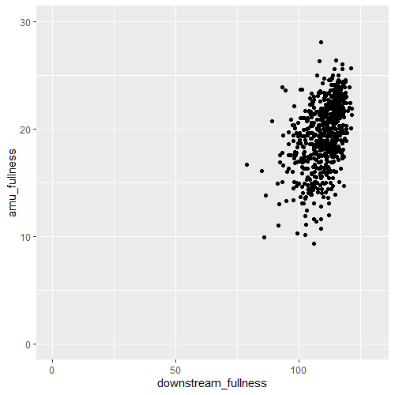
The Top Right Hand Corner of Doom
STEP 2: change the axis scales (I didn’t actually need to, but I wanted to know if I could…)
library(tidyverse)
library(ggplot2)
ggplot(data = trhcod_original) +
geom_point(mapping = aes(x=downstream_fullness, y = amu_fullness)) +
coord_cartesian(xlim = c(0, 130), ylim = c(0, 30))

Slide 7
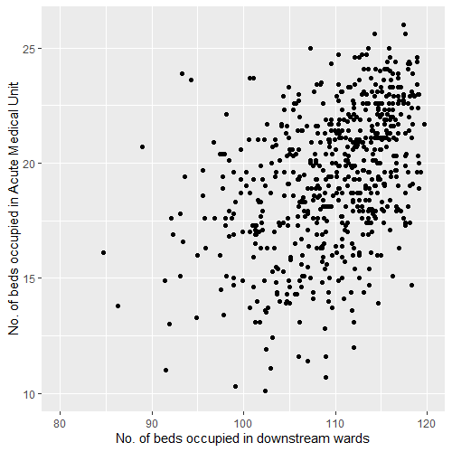
The Top Right Hand Corner of Doom
STEP 3: label the axes more meaningfully (and incidentally use a different method for re-scaling the axes)
library(tidyverse)
library(ggplot2)
ggplot(data = trhcod_original) +
geom_point(mapping = aes(x=downstream_fullness, y = amu_fullness)) +
scale_x_continuous(name = "No. of beds occupied in downstream wards", limits = c(80, 120)) +
scale_y_continuous(name = "No. of beds occupied in Acute Medical Unit", limits = c(10, 26))

Slide 8
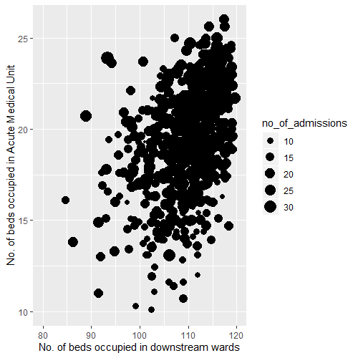
The Top Right Hand Corner of Doom
STEP 4: change it from a scatterplot to a bubbleplot
library(tidyverse)
library(ggplot2)
ggplot(data = trhcod_original) +
geom_point(mapping = aes(x=downstream_fullness, y = amu_fullness, size = no_of_admissions)) +
scale_x_continuous(name = "No. of beds occupied in downstream wards", limits = c(80, 120)) +
scale_y_continuous(name = "No. of beds occupied in Acute Medical Unit", limits = c(10, 26))

Slide 9
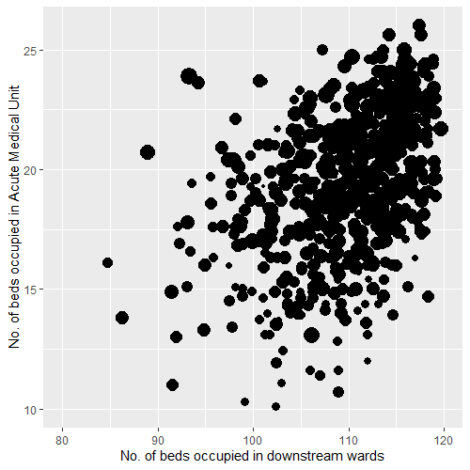
The Top Right Hand Corner of Doom
STEP 5: get rid of the stupid legend
library(tidyverse)
library(ggplot2)
ggplot(data = trhcod_original) +
geom_point(mapping = aes(x=downstream_fullness, y = amu_fullness, size = no_of_admissions),
show.legend = FALSE) +
scale_x_continuous(name = "No. of beds occupied in downstream wards", limits = c(80, 120)) +
scale_y_continuous(name = "No. of beds occupied in Acute Medical Unit", limits = c(10, 26))

Slide 10
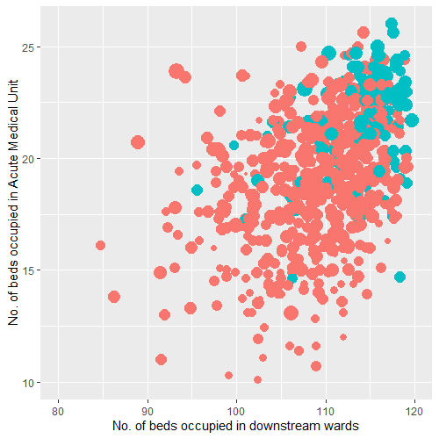
The Top Right Hand Corner of Doom
STEP 6: colour code the dots
library(tidyverse)
library(ggplot2)
ggplot(data = trhcod_original) +
geom_point(mapping = aes(x=downstream_fullness, y = amu_fullness, size = no_of_admissions, color = medical_receiving),
show.legend = FALSE) +
scale_x_continuous(name = "No. of beds occupied in downstream wards", limits = c(80, 120)) +
scale_y_continuous(name = "No. of beds occupied in Acute Medical Unit", limits = c(10, 26))

Slide 11
The Top Right Hand Corner of Doom
STEP 7: superimpose the grid
library(tidyverse)
library(ggplot2)
ggplot(data = trhcod_original) +
geom_point(mapping = aes(x=downstream_fullness, y = amu_fullness, size = no_of_admissions, color = medical_receiving),
show.legend = FALSE) +
scale_x_continuous(name = "No. of beds occupied in downstream wards", limits = c(80, 120)) +
scale_y_continuous(name = "No. of beds occupied in Acute Medical Unit", limits = c(10, 26))

Slide 12
Wrangle…

Slide 13
Redefining specialty stays
STEP 1: Load libraries
library(tidyverse) #library to manipulate the data
library(readxl) #to read in the xlsx file

Slide 14
Redefining specialty stays
STEP 2: Load the data
file_path <- 'C:/Users/neilp/Dropbox/Code/kurtosis.co.uk/content/Project R'
#amend this with the path that you have stored the file in
#Take care to replace the \ with / for some reason, R prefers forward slashes
file_name <- 'A_2018_Sample_Data.xlsx'
#Name of the file to be uploaded
data_input <- readxl::read_excel(path = paste(file_path, file_name, sep = '/'))
#Load the data using the file_path and the file_name
#This part doesn't need to be changed unless there are multiple sheets -
#if there are multiple sheets, just put in ,sheet = 'Name of sheet' after the penultimate closing bracket

Slide 15
Redefining specialty stays
STEP 3: Check the data
head(data_input)
#look at the first 6 rows of the data
summary(data_input)
#get a feel of the data - character or numerical

Slide 16
Redefining specialty stays
STEP 4: Wrangle the data (1)
#Create a variable for each patient ID with the first and final start date listed
data_first_final <- data_input %>%
#create a variable called data_first_final from the data_input variable
group_by(SEQ_NO) %>%
#group by the Patient ID
summarise(First_Start_Date = min(START_DATE_ALIAS),
#Find the first episode by taking the earliest start date
Final_End_Date = max(END_DATE_ALIAS)) %>%
#Find the end of the last episode by taking the latest end date
ungroup() %>%
#ungroup to allow the data to be used easier later on

Slide 17
Redefining specialty stays
STEP 4: Wrangle the data (2)
mutate(CUMULATIVE_LOS_DAYS = ((Final_End_Date - First_Start_Date)/(24*60*60)))
#Create a new column called cumulative LOS days from the Final End Date and First Start Date
#The Final_End_Date - First_Start_Date is calculated in seconds so I divided by 86400 to get into days
#Create a variable with just the patient IDs, consultant alias codes and the end dates
data_consultant_dates <- data_input %>%
#create new variable from the data_input variable
select(SEQ_NO, CONS_ALIAS, END_DATE_ALIAS)
#select only the 3 columns

Slide 18
Redefining specialty stays
STEP 4: Wrangle the data (3)
#Join together information from the last 2 variables (data_first_final and data_consultant_dates)
data_wrangling <- data_first_final %>%
#create a new variable from the first and final dates variable
left_join(data_consultant_dates,
#left join the data_consultant_dates variable on
by = c('SEQ_NO' = 'SEQ_NO',
#join on patient id
'Final_End_Date' = 'END_DATE_ALIAS')) %>%
#join final end date in the data_first_final variable to the end date in the data_consultant_dates variable
select(SEQ_NO, First_Start_Date, Final_End_Date, CUMULATIVE_LOS_DAYS, CONS_ALIAS)
#select only the specified columns

Slide 19
Redefining specialty stays
STEP 5: Export the data
export_file <- 'Sample_Data_export.csv'
#Name of the file to be exported
write.csv(data_wrangling,
#take the data in data_wrangling variable and write to a CSV file
paste(file_path,
#use the file path in the file_path variable (created at the top of this file)
export_file,
#use export_file as the name of the file
sep = '/'),
#separate the file_path and the export_file by a / so it forms a correct and complete file path
row.names = FALSE)
#don't put row ID numbers

Slide 20
What I learnt…
1. The language
5. The community
2. The metaphor
6. Where next..?
3. The approach
4. My mentors

Slide 21


